Slide 1
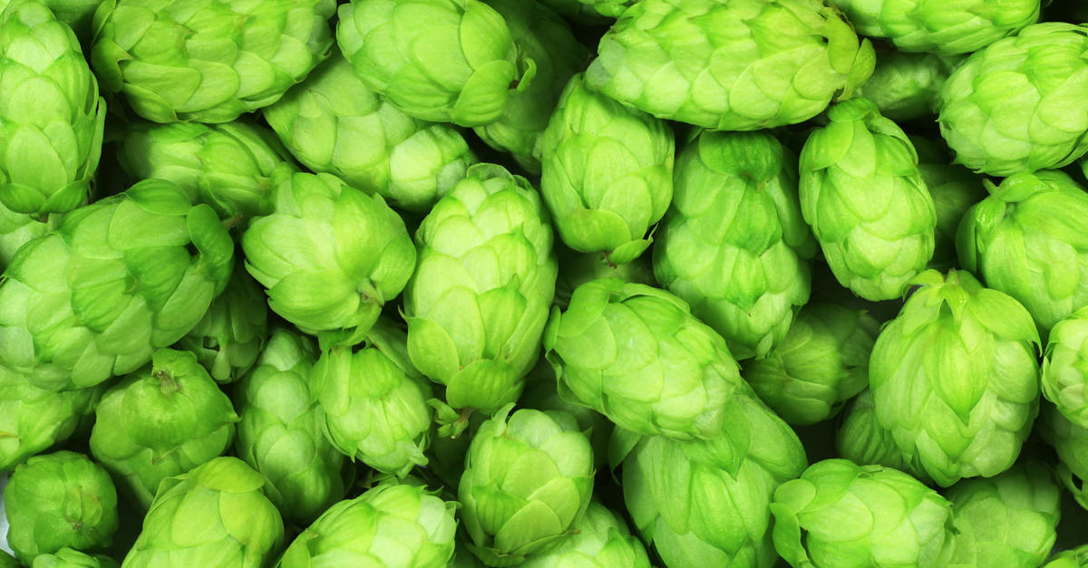
Spatial Distribution of New England Craft Breweries
New England craft brew
Creates juicy tastes for you
Ending the Haiku
Presented by Drew Rosebush 3/9/2018

Slide 2

What is a craft brewery?
Small – limited production
Independent – maintains a level of autonomy
Traditional – follows traditional brewing methods
Notes:
ArcGIS

Slide 3

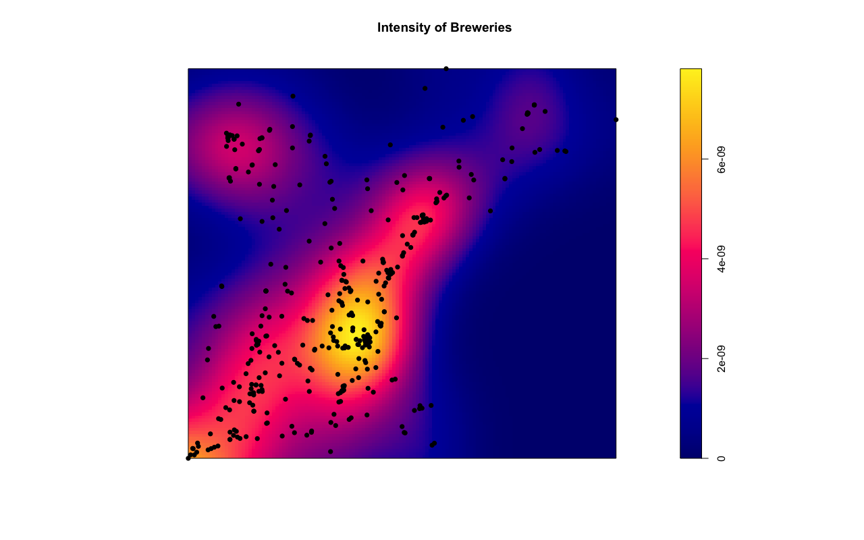
Spatial Patterns
Spatial Heterogeneity
Large scale spatial trends
Spatial Dependence
Localized spatial interactions
“Everything is related to everything else, but near things are more related than distant things.” - Tobler
Notes:
Used R to generate these visualizations.
Top Fig: used to show trend… as you get further north you see fewer breweries.
Bottom Fig: Show’s concentration or breweries in New England

Slide 4
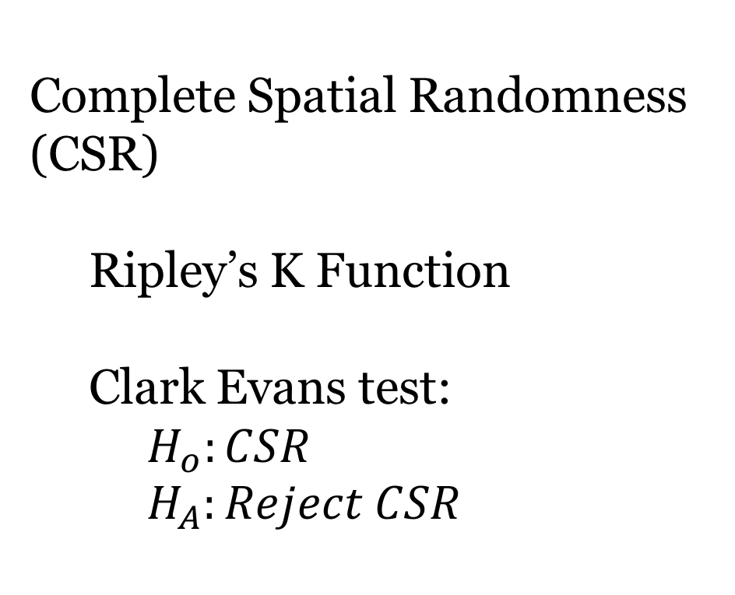
Spatial Clustering
Complete Spatial Randomness (CSR)
Ripley’s K Function
Clark Evans test:
$H_{o}:CSR$
$H_{A}:Reject CSR$
Notes:
Top Fig: test for complete spatial randomness (i.e. testing the idea that brewery locations are not random)
Bottom Fig: visualizing the concentrations/intensities of breweries. In the presentation I would point out cities and towns associated with breweries. Burlington, Bangor, Portland, Boston
Used R to generate these visualizations.

Slide 5
Data – ESRI (spatial) & US Census
Notes:
Table generated in Stata

Slide 6
Results
Model Specification
Controls
Population
Income
Income Squared
Variables of interest
Age
M/F Ratio
Notes:
Table generated in R
NB – Negative Binomial which is a type of count model. Because the data does not follow a specific data rule (equidispersion) to use a Poisson

Slide 7
Results – Spatial
Residual Map
Moran’s I Statistic: 0.133
Monte Carlo simulations
Notes:
Created in Geoda.
Figures test for second order spatial autocorrelation.
Left: Montecarlo simulation to determine whether or not spatial randomness exists
Right: Visualizing the model residuals.

